Slide 1
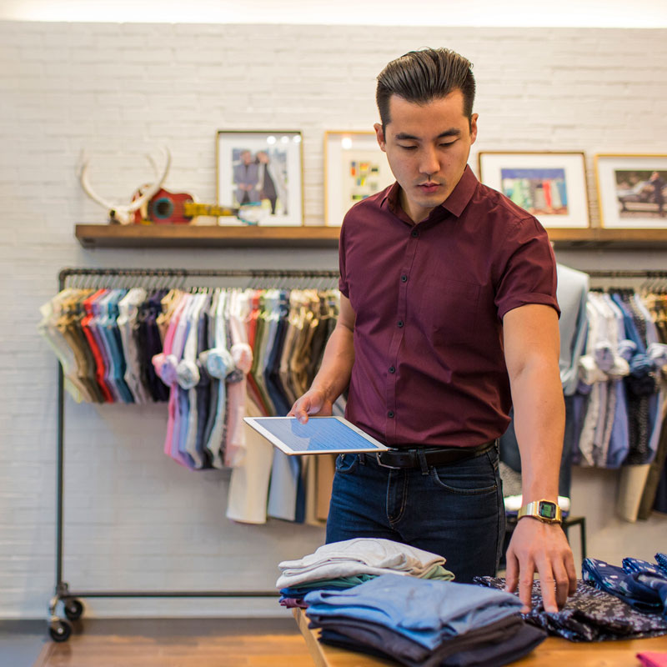
The Journey to the DIGITAL WORKSPACE

Slide 2
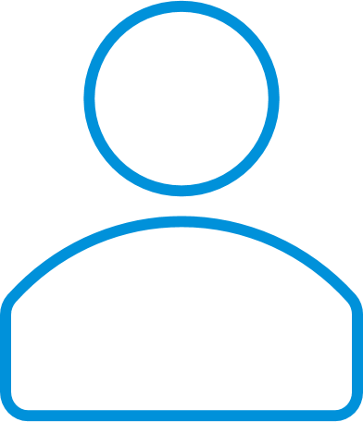
APPLICATIONS
DESKTOP
ACCESS
MOBILE

Slide 3
Desktop
APPLICATIONS
DESKTOP
PCLM
Web
AD/GPO
SaaS
Traditional Tools
Mobile
On-prem Identity
MAM/MDM
Cloud Identity
BYO
Limited SSO
ACCESS
MOBILE

Slide 4
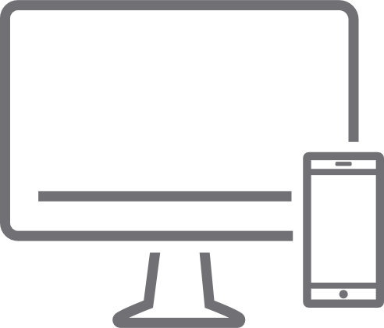
Desktop
APPLICATIONS
DESKTOP
PCLM
Web
ANY APPLICATION
AD/GPO
SaaS
Traditional Tools
Mobile
Any App, Any Device
On-prem Identity
ON-PREM AND CLOUD
MAM/MDM
Cloud Identity
WORKSPACE ONE
BYO
Limited SSO
SSO
ACCESS
MOBILE

Slide 5
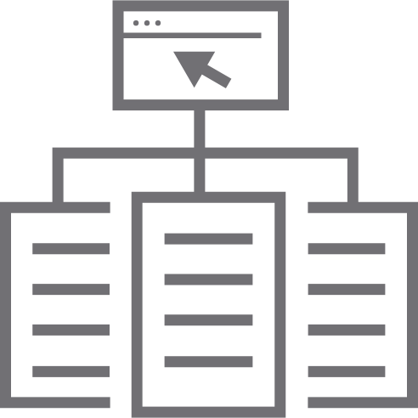
APPLICATIONS
DESKTOP
PCLM
ANY APPLICATION
WORKSPACE ONE
AD/GPO
Traditional Tools
Any App, Any Device
Unified Endpoint Management
ON-PREM AND CLOUD
WORKSPACE ONE
SSO
ACCESS
MOBILE

Slide 6
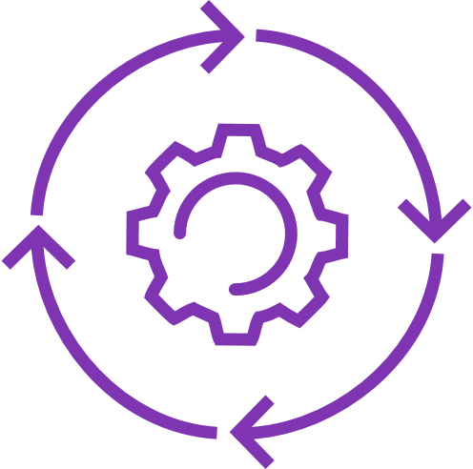
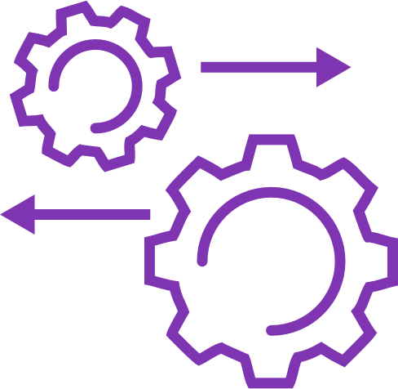
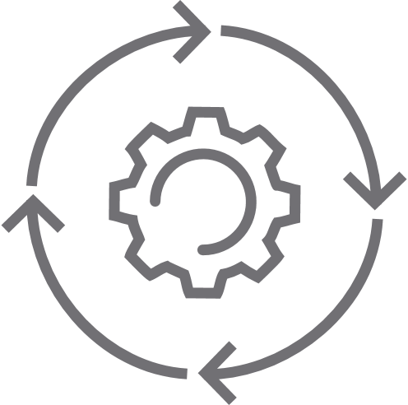
USER CENTRIC WORKSPACE
APPLICATIONS
DESKTOP
ANY APPLICATION
WORKSPACE ONE
Any App, Any Device
Unified Endpoint Management
Intelligence and Mobile Flows
Trust Network
ON-PREM AND CLOUD
WORKSPACE ONE
SSO
ACCESS
BEST EMPLOYEE EXPERIENCE
MOBILE

Slide 7
USER CENTRIC WORKSPACE
APPLICATIONS
DESKTOP
ANY APPLICATION
WORKSPACE ONE
Any App, Any Device
Unified Endpoint Management
Intelligence and Mobile Flows
Trust Network
ON-PREM AND CLOUD
WORKSPACE ONE
SSO
ACCESS
BEST EMPLOYEE EXPERIENCE
MOBILE

